Slide 1
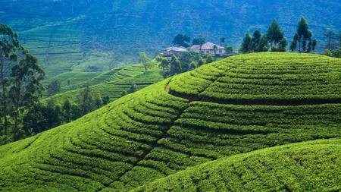
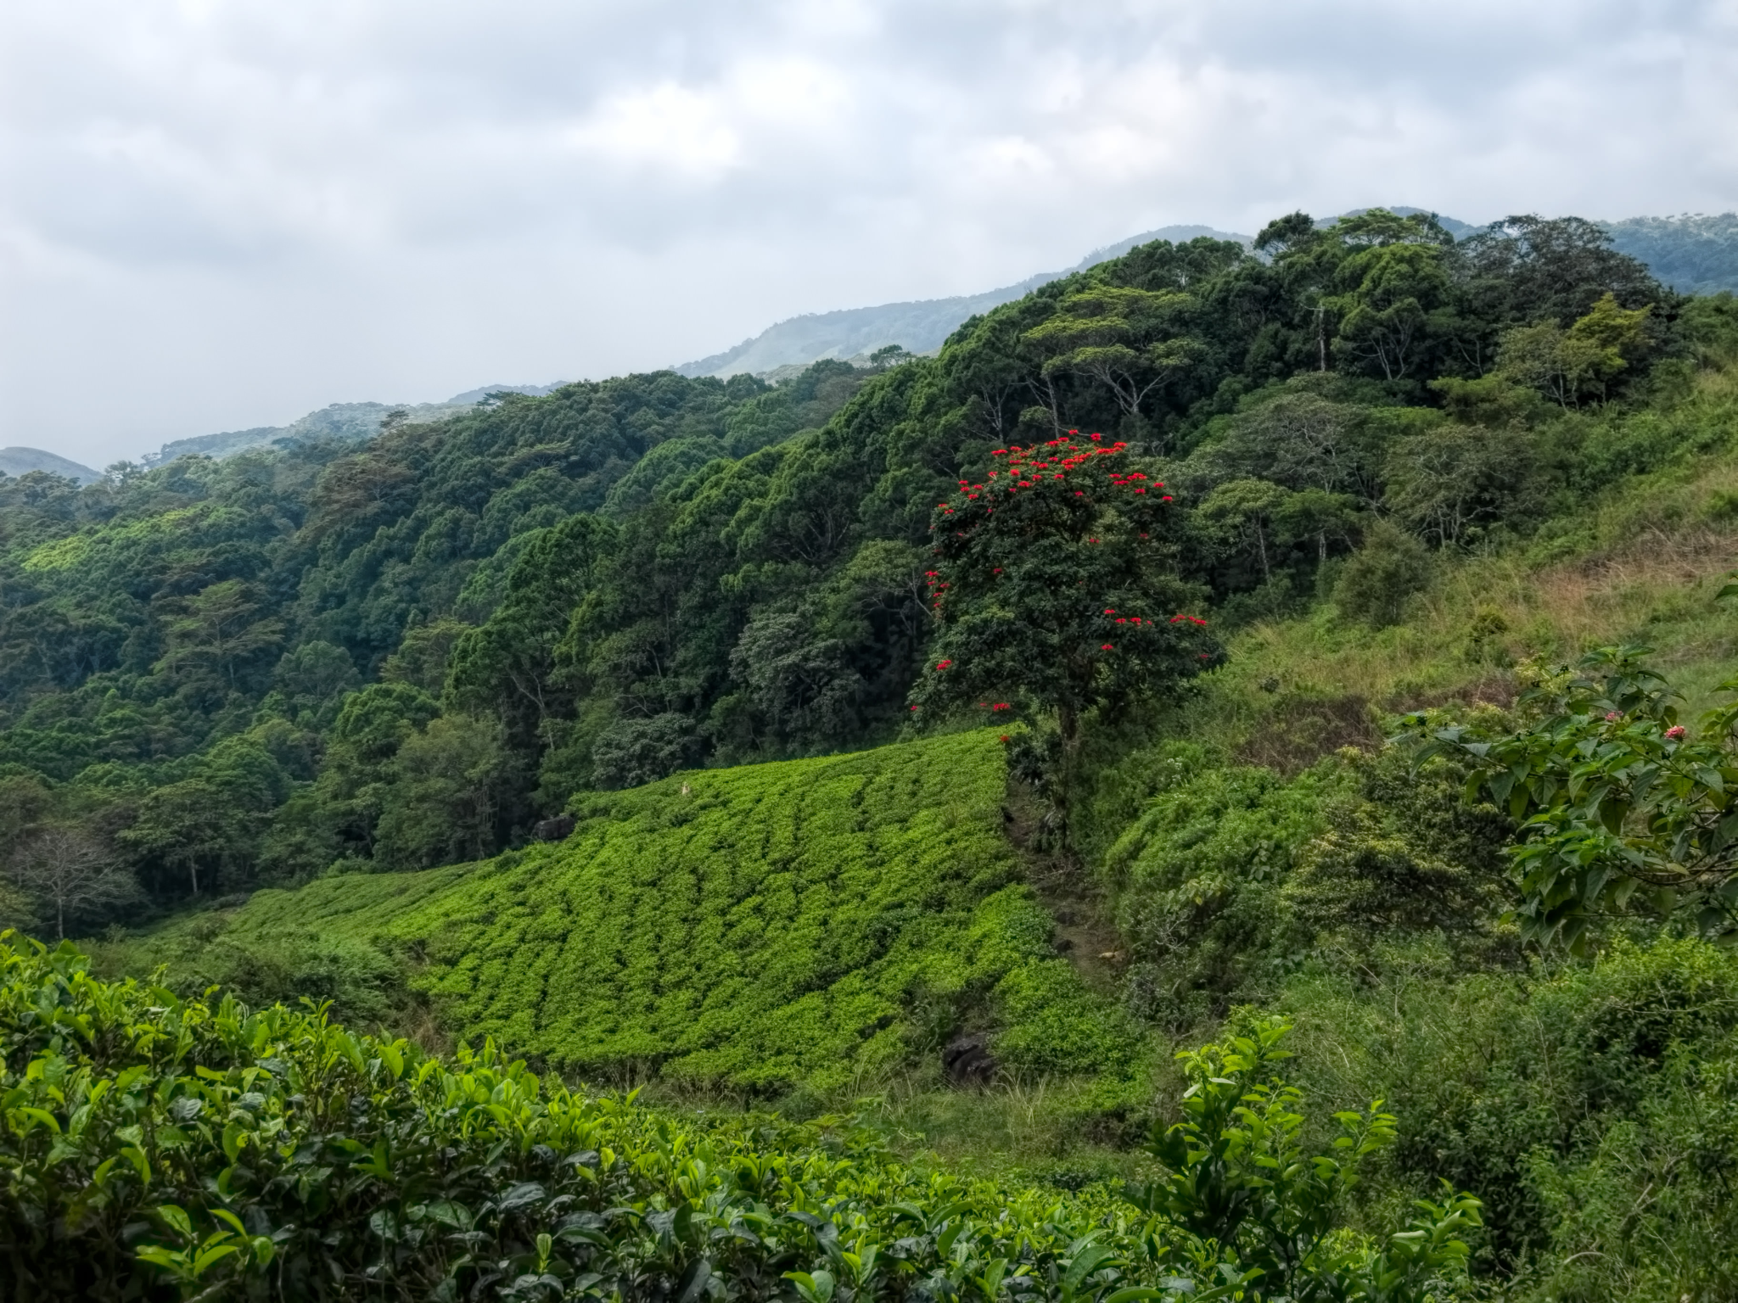
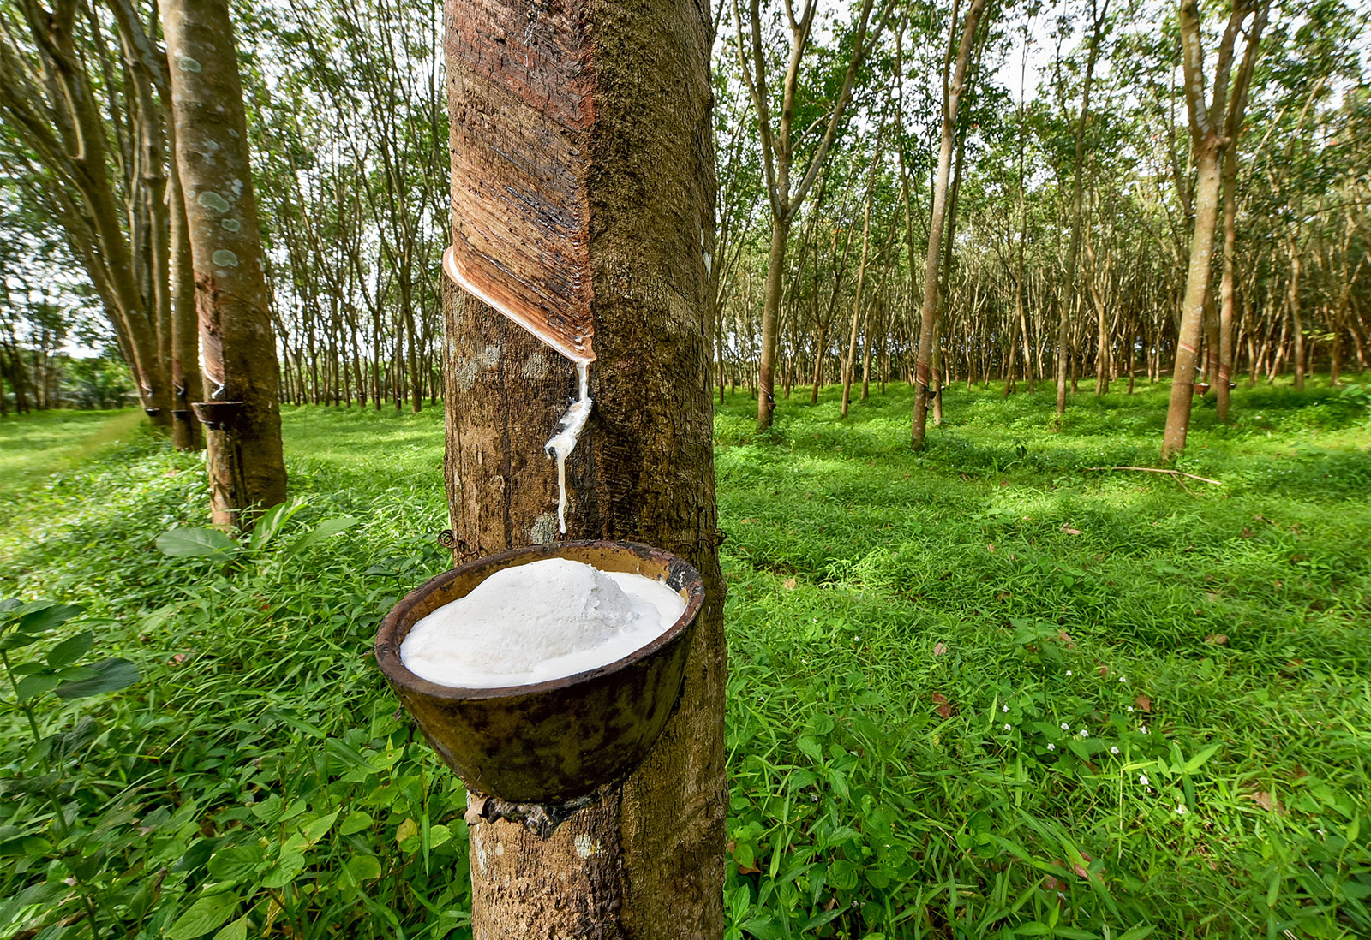
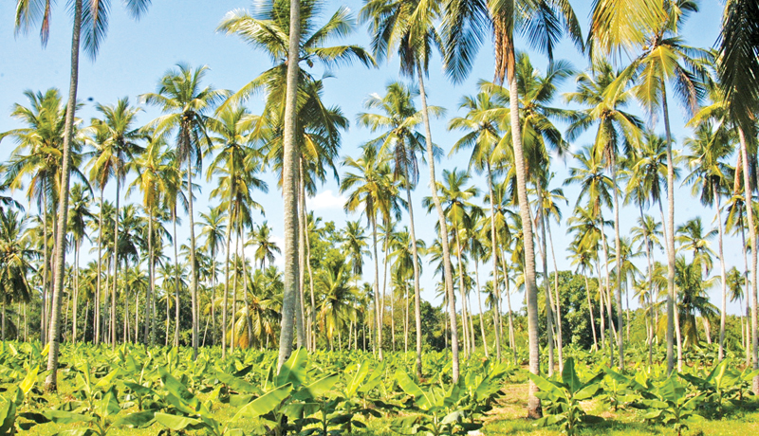
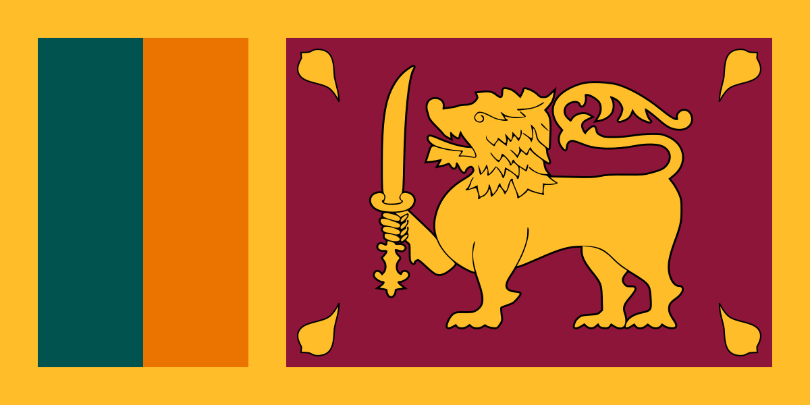
Sri Lanka.

Slide 2
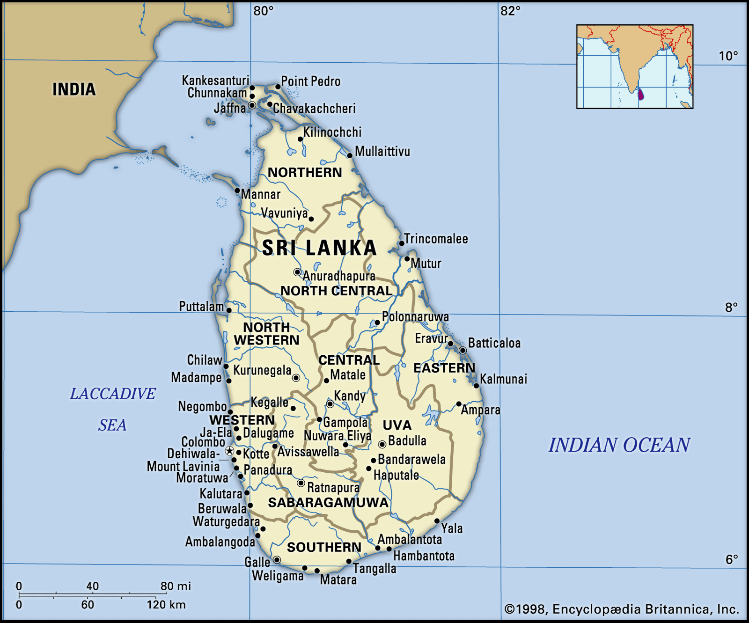
Sri Lanka
Tropical Island off the South-eastern coast of India. Part of the Indian subcontinent.
Developing country.
HDI: 0782. 72nd.
‘High’ Human development index.
Population: ~ 22,156,000 as of 2020.
Economy Primary exports: Clothing and textiles, Tea.
Secondary exports: Coconuts, rubber, fish, Spices, gemstones.
Ecoregions include: Tropical and subtropical broadleaf forest (Both lowland and montane), Tropical and subtropical dry broadleaf forests, Shrublands, Savannah grasslands, Temperate montane peak.
Monsoonal climate. North and South experience wet and dry seasons at different times of year.

Slide 3
Endemic Species
34 known endemic bird species.
21 known endemic mammal species. Unique subspecies of e.g. Asian Elephant (Sri Lankan elephant) (Elephas maximus maximus).
54 endemic snake species.
Also recently discovered endemic geckos and skinks.
90 of 120 known amphibian species are endemic. Highest amphibian endemism in Asia.
53 of 95 known freshwater fish species are endemic.
Many endemic invertebrates, consisting of multiple taxonomic groups.
Many endemic plant species.

Slide 4
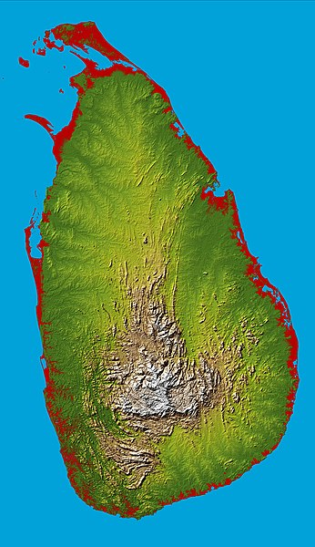
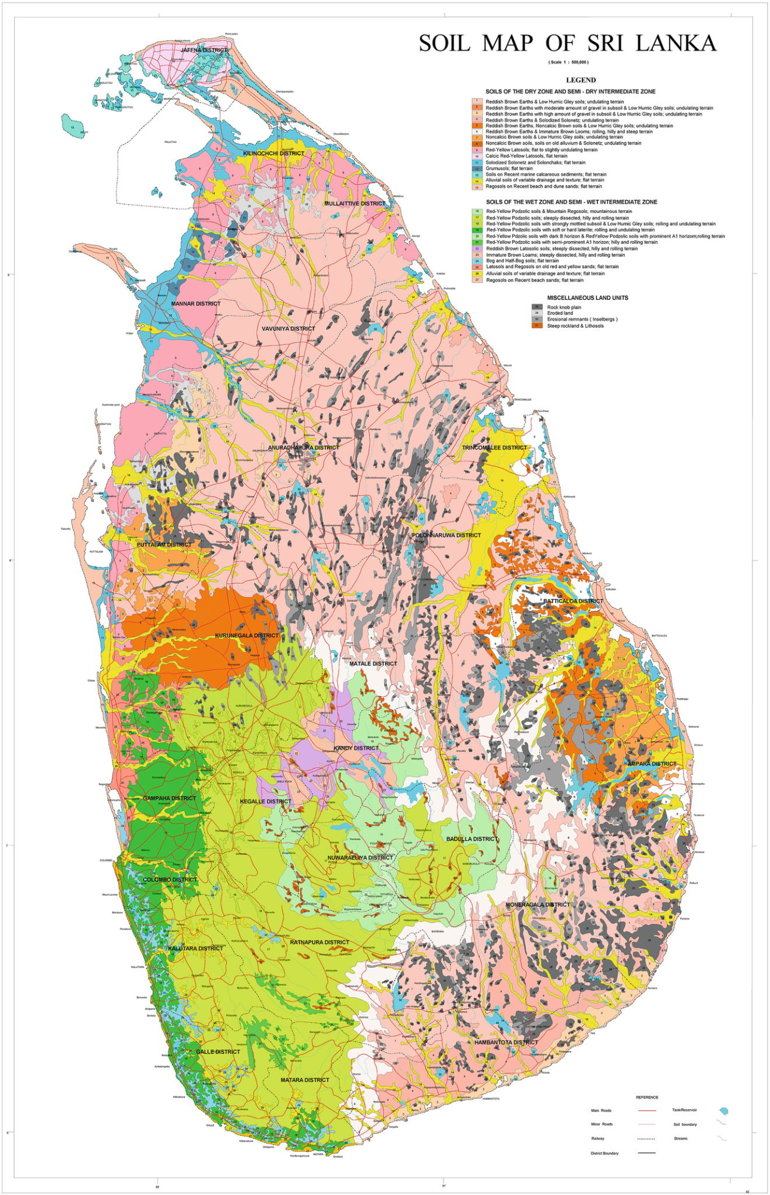
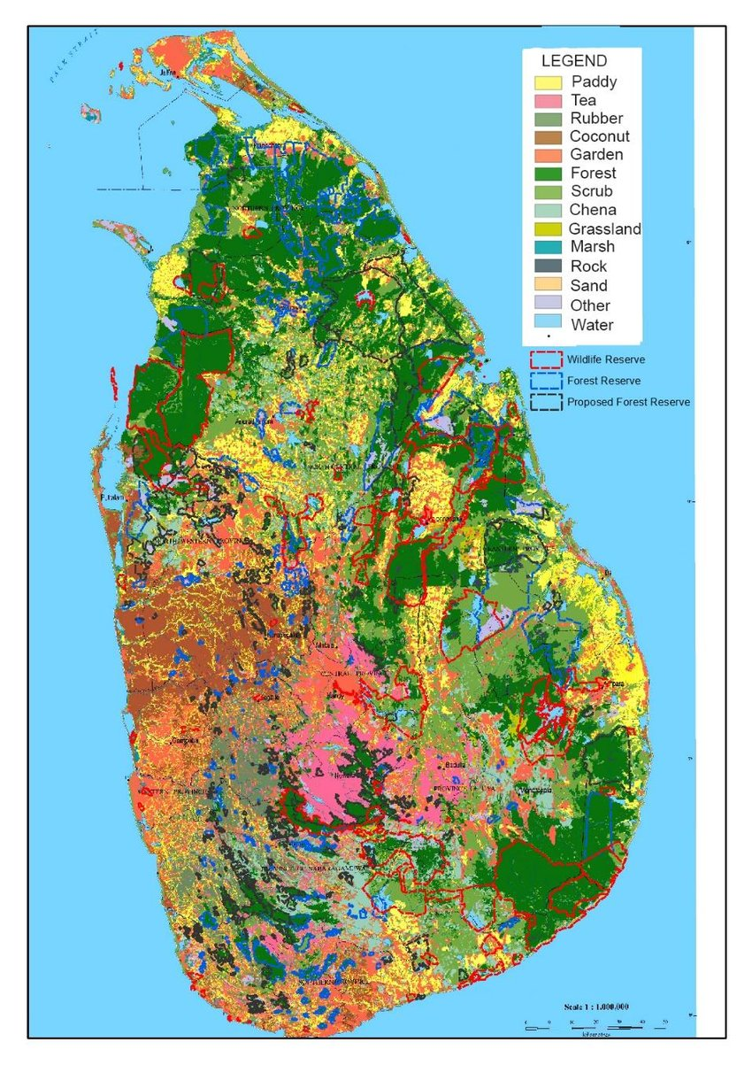
Ecoregion characteristics.
Land use with red outlines showing protected areas.
Topography
Soil types

Slide 5
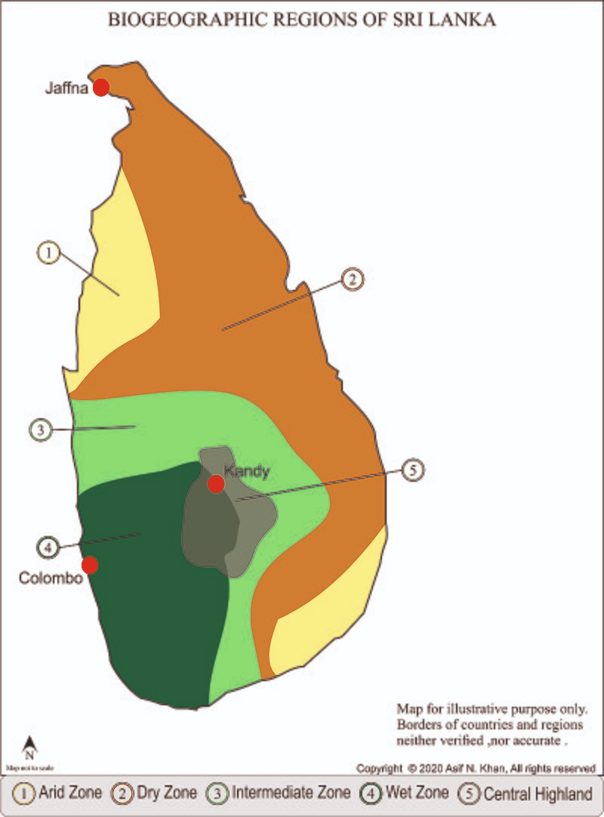
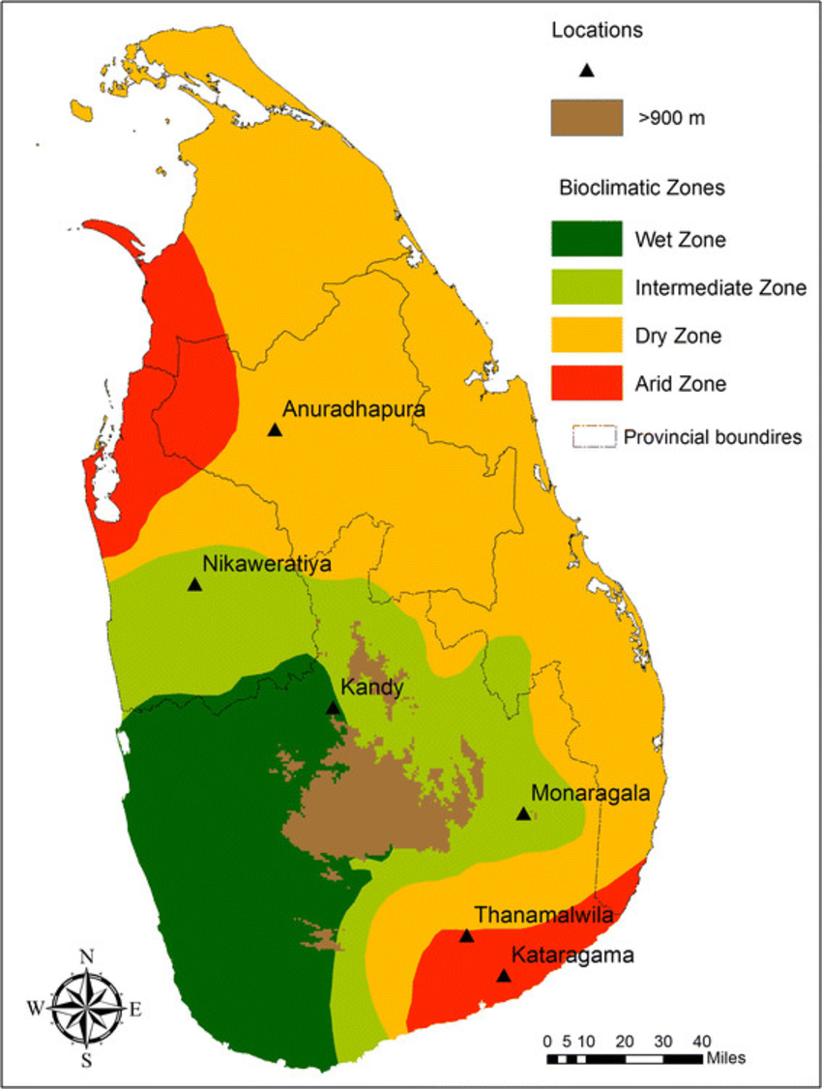
Climatic zones of Sri Lanka.

Slide 6
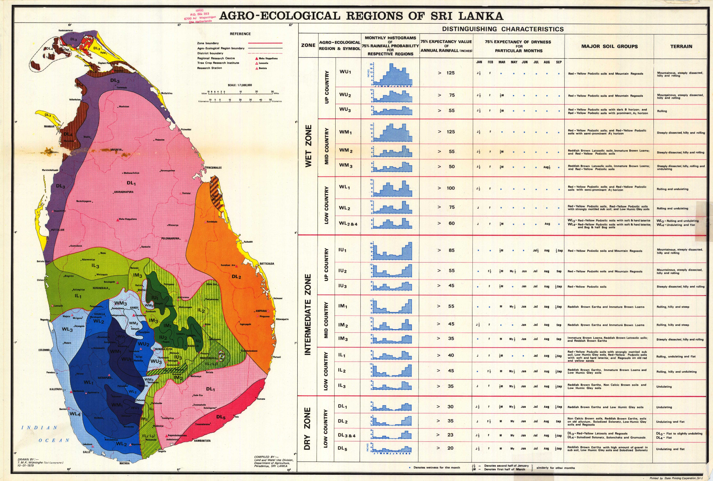
Agro-Ecological regions.

Slide 7
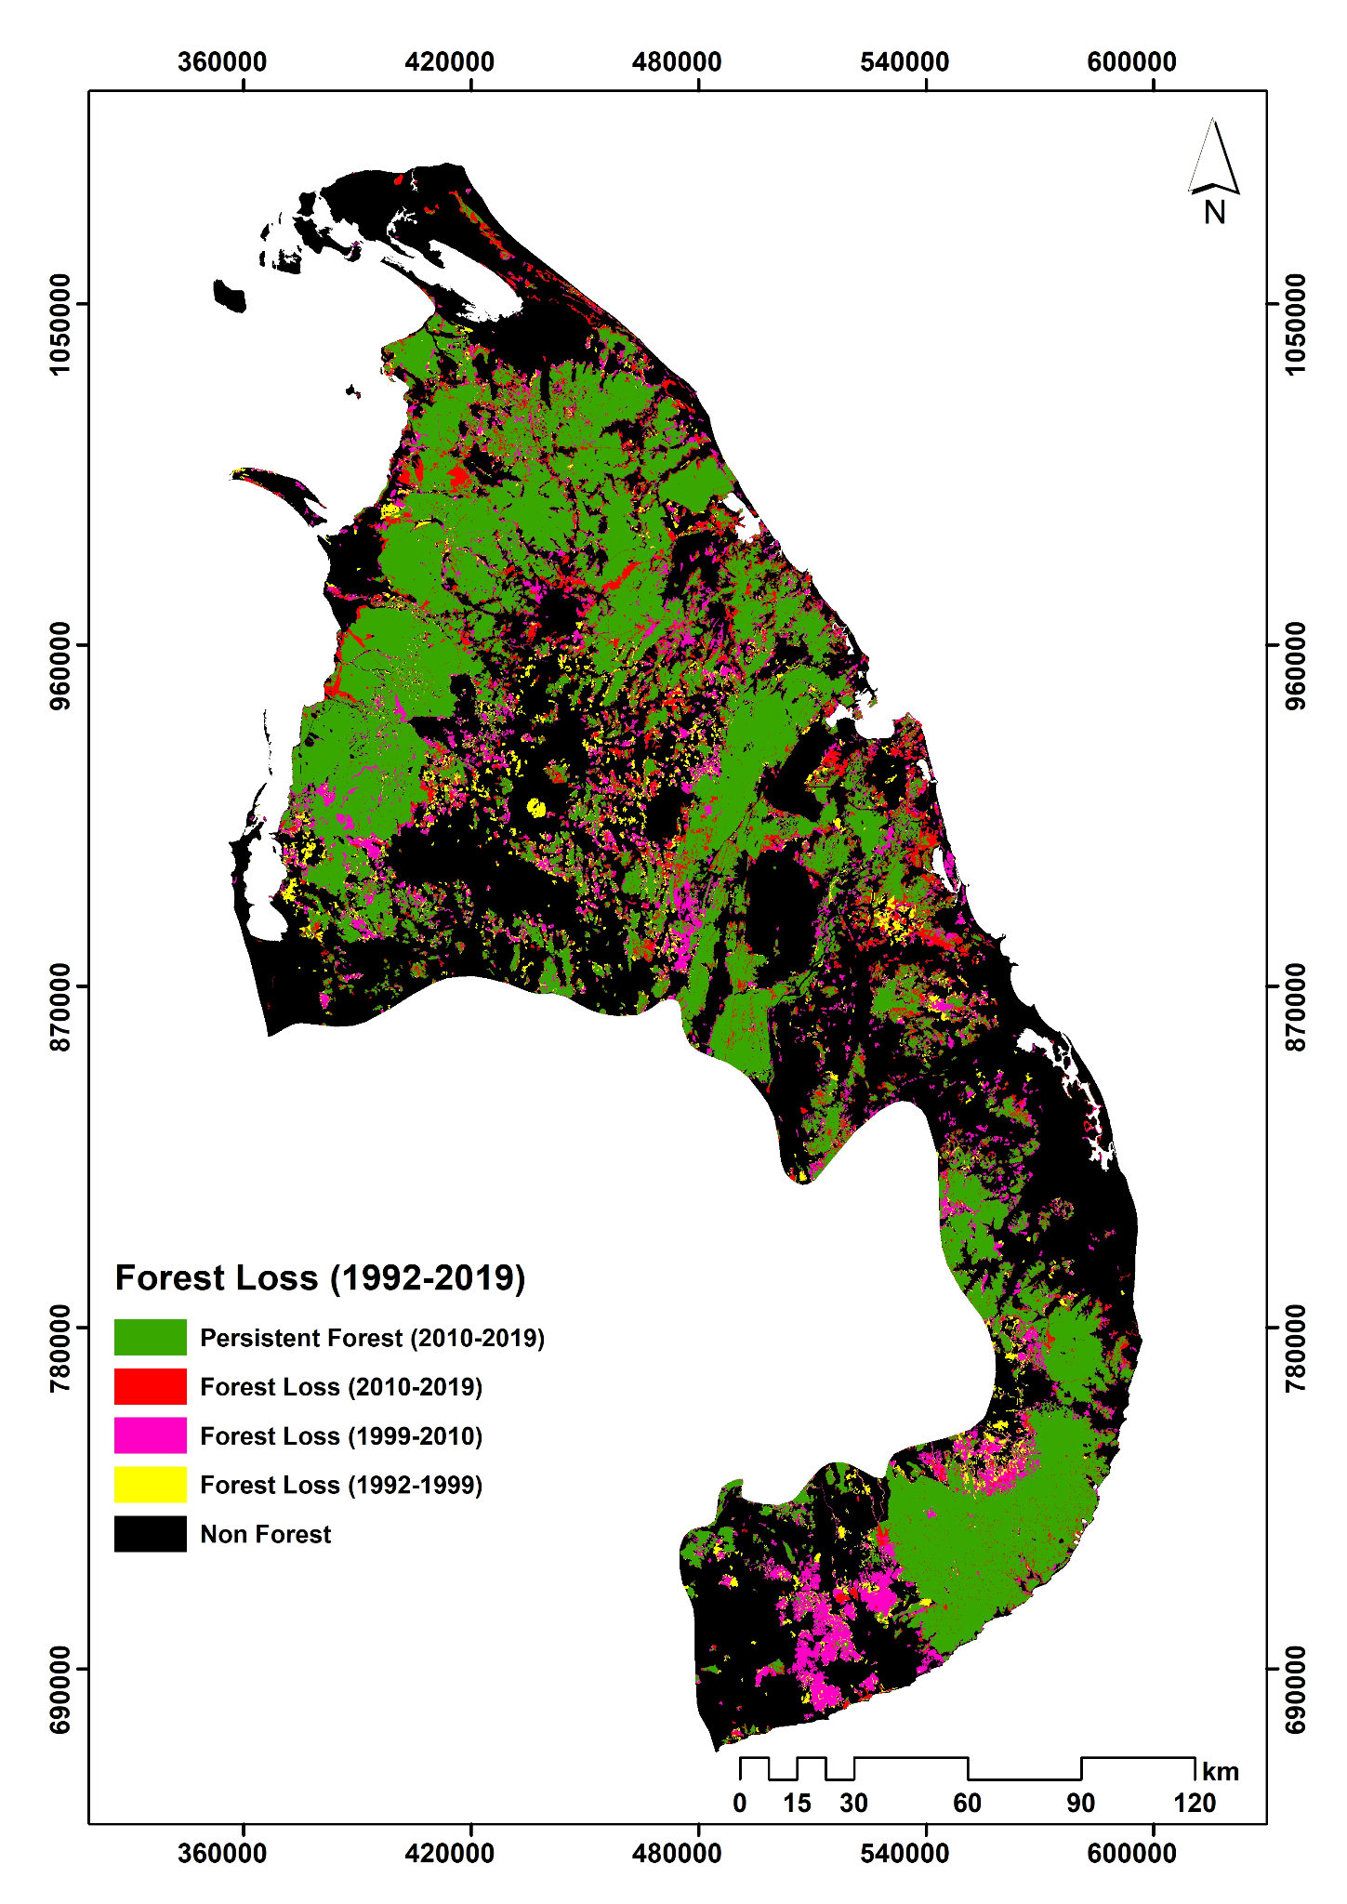
Forest loss

Slide 8
Protected areas.

Slide 9
Forests and land use.
Whilst the Hansen map show many parts of Sri Lanka as ‘forest’, many of the areas in the western part of the country consists of coconut and rubber plantations.
The southern Central Highland zone of the island consists primarily of Tea plantations.
Most of the protected areas exist within remaining intact forests habitats.
Protected areas in Sri Lanka next to map of land use.

Slide 10
Changes in human population and % forest cover.

Slide 11
Some of the causes.
“As a developing country, Sri Lanka has rapidly improved its economy and has undergone quick industrialization, which leads to increased energy consumption.” (Ranaraja et al, 2019).
Tea and rubber industries were introduced during British rule. James Taylor established Tea industry and director of Kew Gardens Sir Joseph Hooker recommended Rubber seeds be introduced. These were the basis of the thriving rubber and tea industries that continue to this day and contribute to the economy. Different zones were used for different crops.
Since independence, increased industrialisation and more recent industries lead to more forest clearing.
“About 200 years back Sri Lanka was almost entirely covered by forests, That was 90% of the total land surface. As described above, with the increasing industrialization, the rate of deforestation rapidly accelerated. Timber demand increased and forests were cleared for various types of economical plantations, such as Tea, Rubber , Coconut etc. Chena cultivation spread more widely with devastating results on the forest cover. The government established ply-wood industries and other timber companies that mainly contribute to the deforestation, especially in the wet zone.” (Ranaraja et al, 2019). This has nonetheless also had benefits, leading to economic growth and increased development. Sri lankan Tea is world famous.
Covid-19 has also caused the country to declare and economic emergency. Decline in the value of their currency has caused increase in food prices. Pandemic also reduced tourism which provided an additional source of income. Lockdown restrictions provided an opportunity for illegal loggers to encroach on nature preserves.

Slide 12
Solutions.
Protected areas and sustainable forest policy have helped to reduce the rate of deforestation in certain parts of the country.
Deforestation rates have decreased by 35% since 1990s due to conservation measures.

