Slide 1
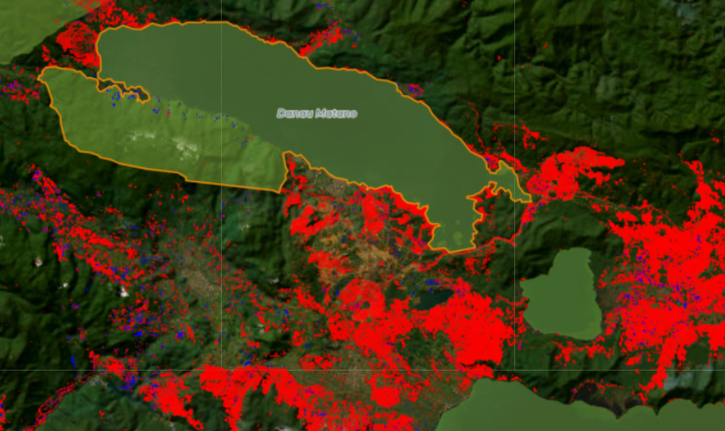
Danau Matano

Slide 2
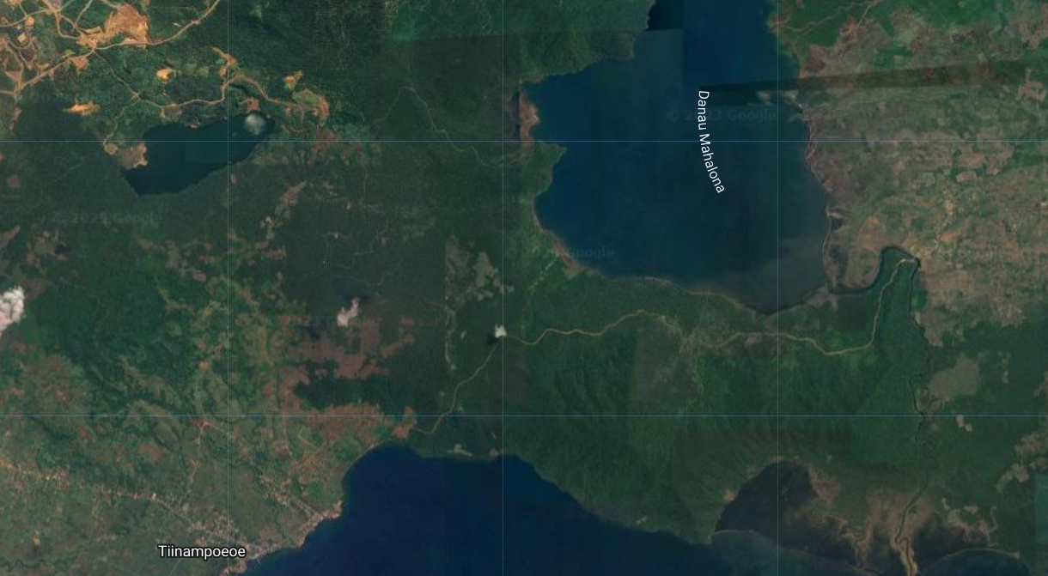

Slide 3
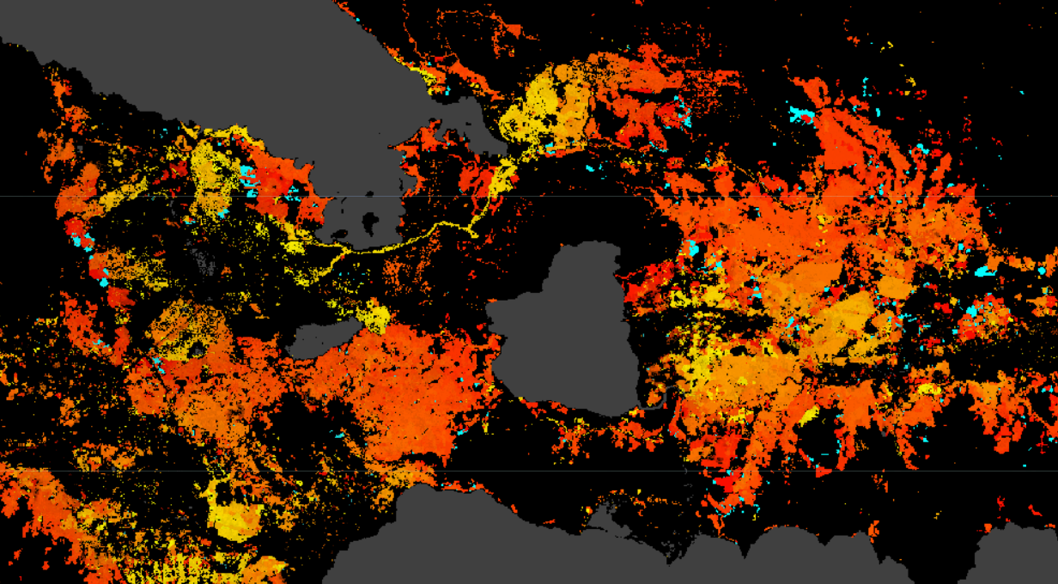

Slide 4
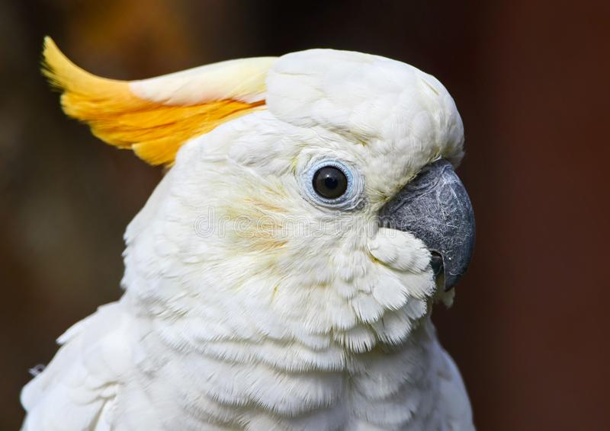
Conservation Impact
315 species assessed by the IUCN
22 Near Threatened
15 Vulnerable
5 Endangered
1 Critically Endangered
Yellow-crested Cockatoo cacatua sulphurea

Slide 5
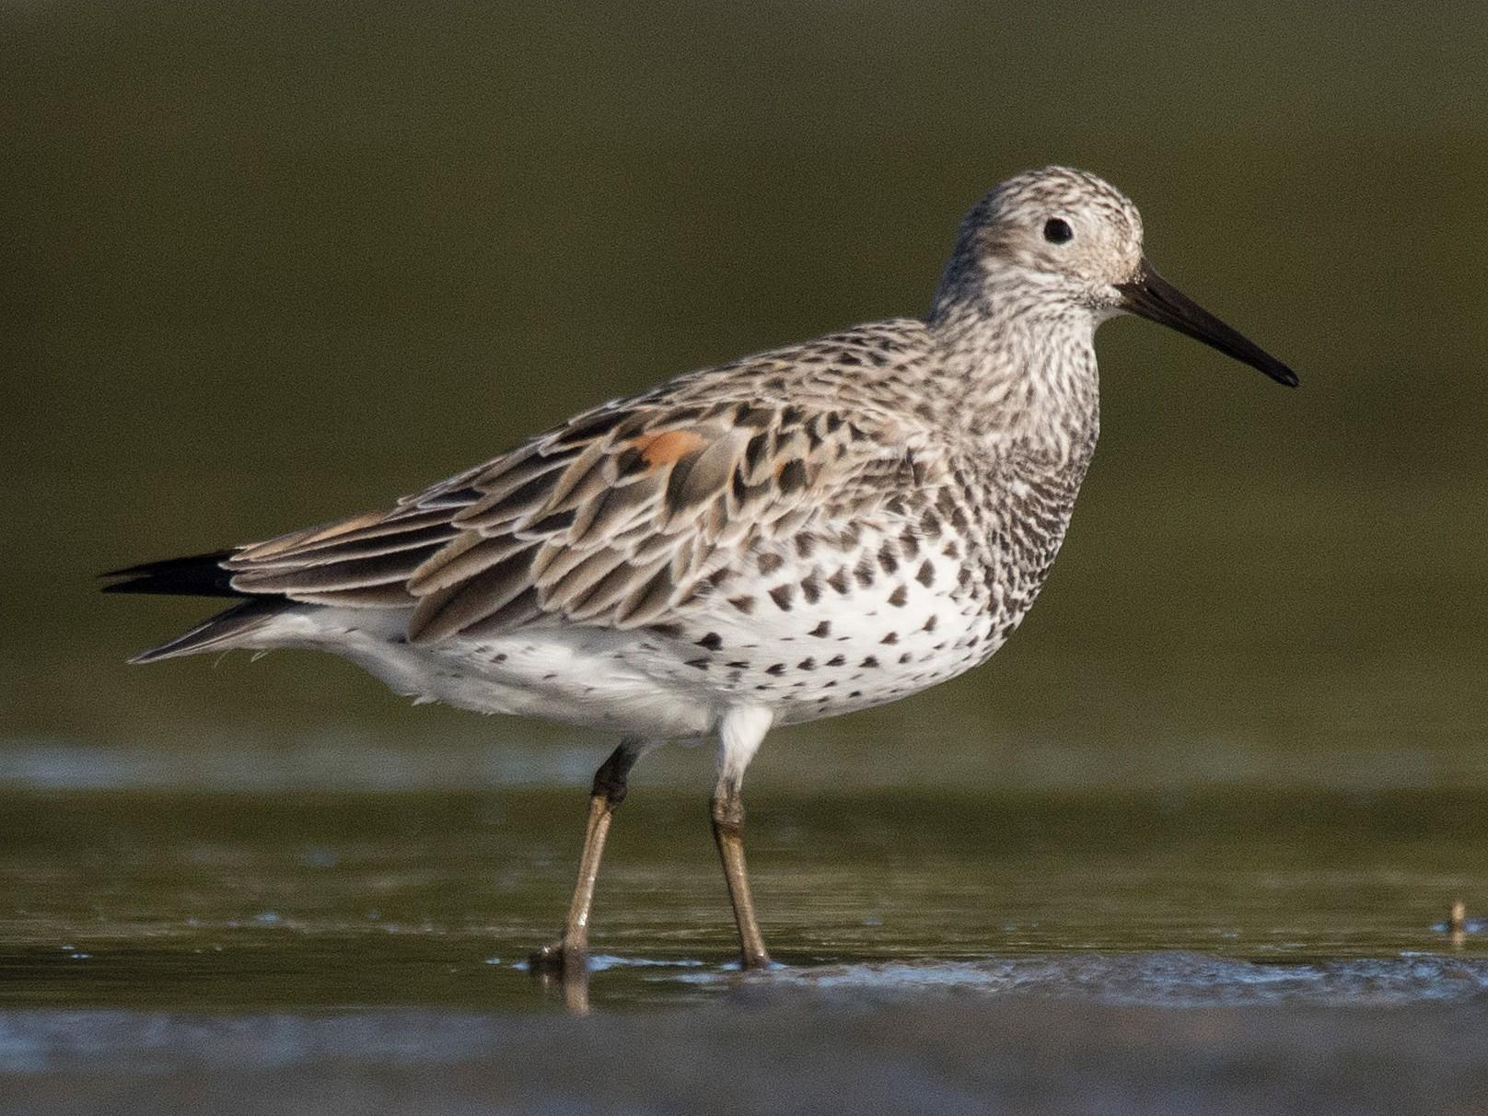
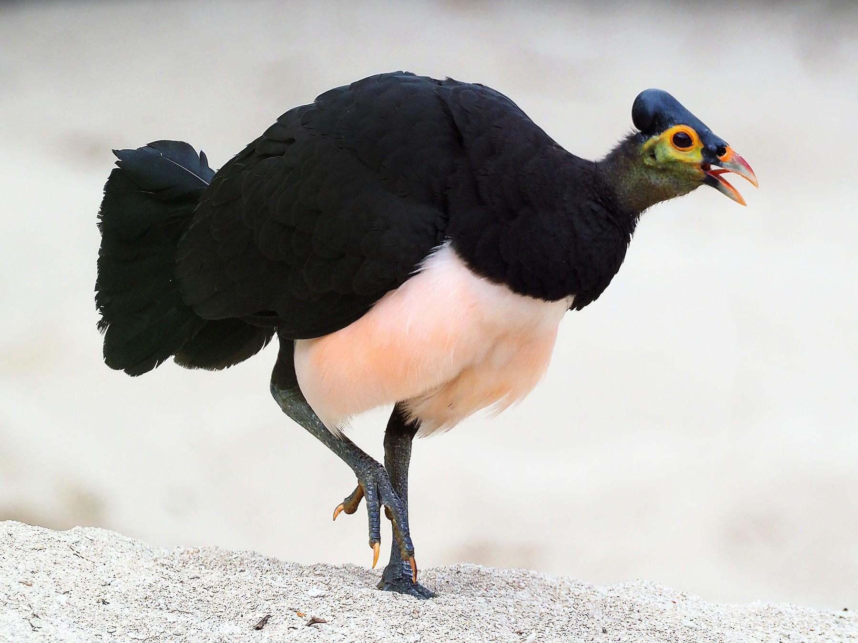
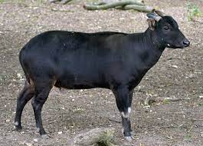
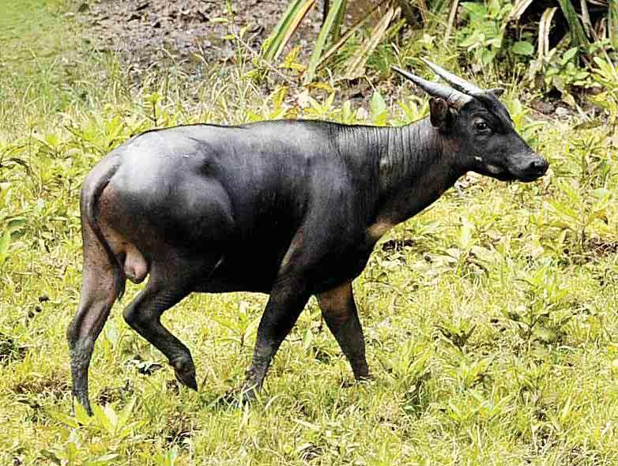
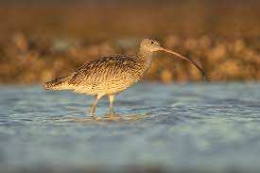
Threatened species (IUCN Endangered)
Great Knot Calidris tenuirostris
Maleo Macrocephalon maleo
Far Eastern Curlew numenius madagascariensis
Lowland Anoa bubalus depressicornis
Mountain Anoa bubalus quarlesi

Slide 6
