Slide 1
Central America and Mexico

Slide 2
Countries and datasets
Honduras: Data set 1994 - 2017
Nicaragua: Date set 2007-2017
Guatemala: Data set 1970 - 2017
Belize: Date set Unavailable
El Salvador: Data set 1994 - 2017
Mexico 1960 -2017
Costa Rica: Data set unavailable
Forest cover loss 2000-2019

Slide 3
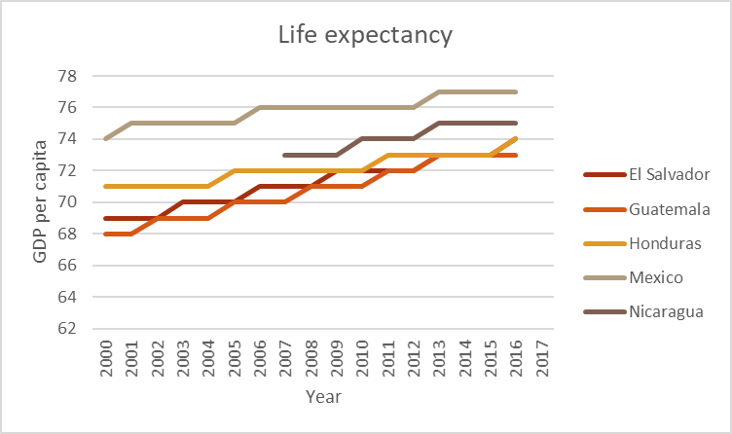
Life expectancy

Slide 4
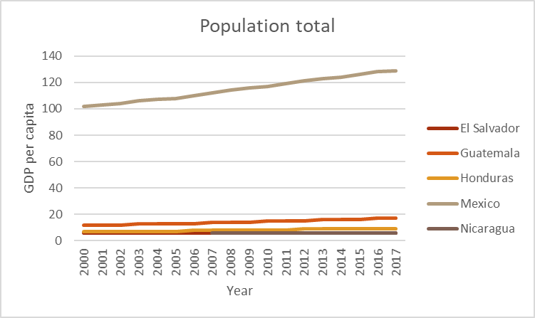
Population total

Slide 5
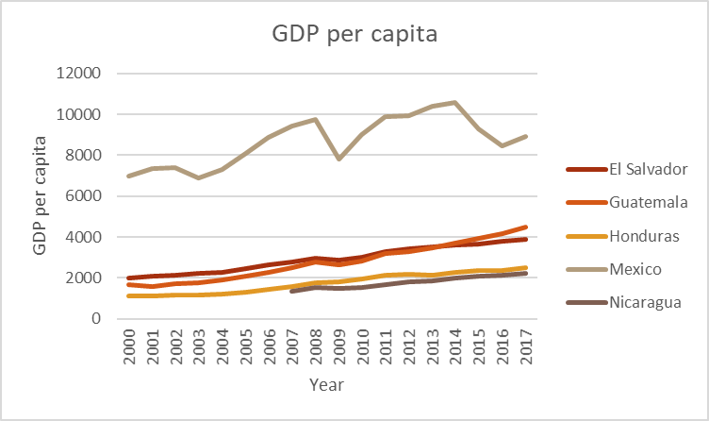
GDP per capita

Slide 6
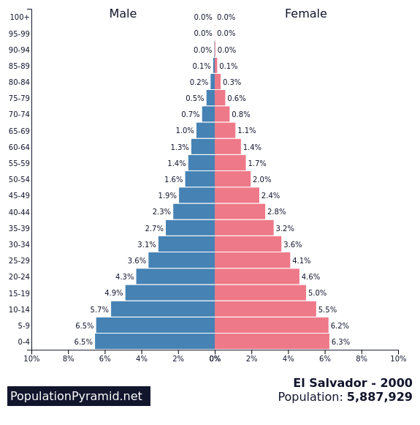
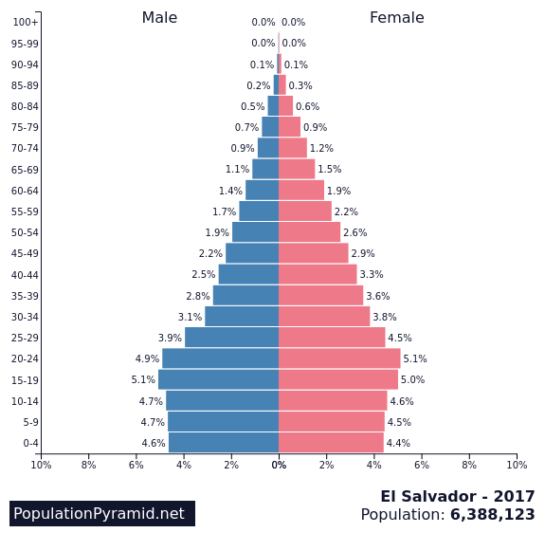
El Salvador

Slide 7
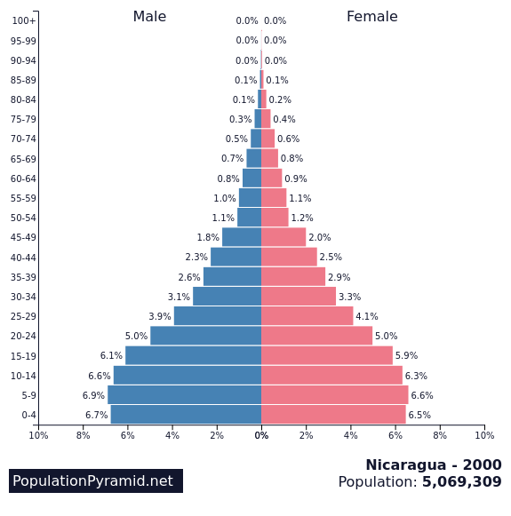
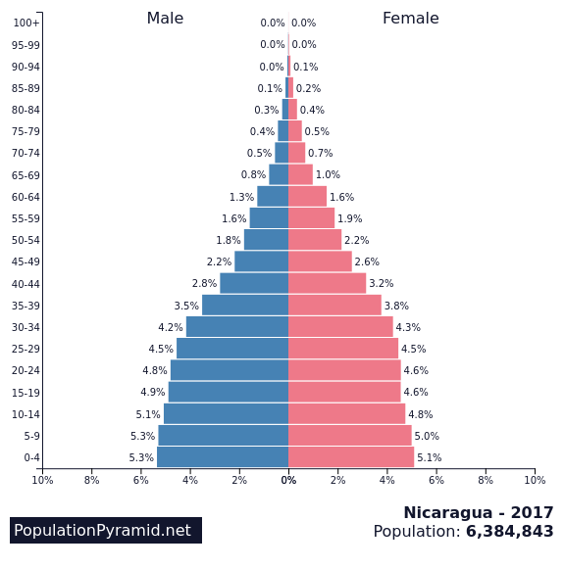
Nicaragua

Slide 8
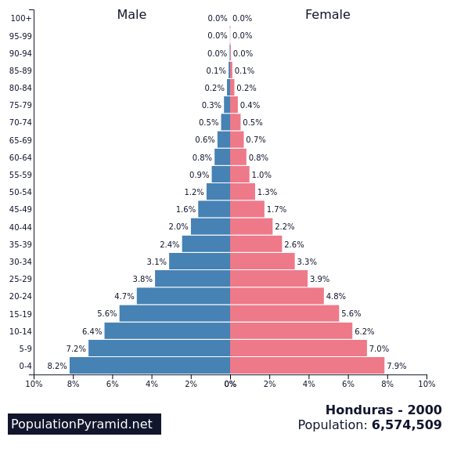
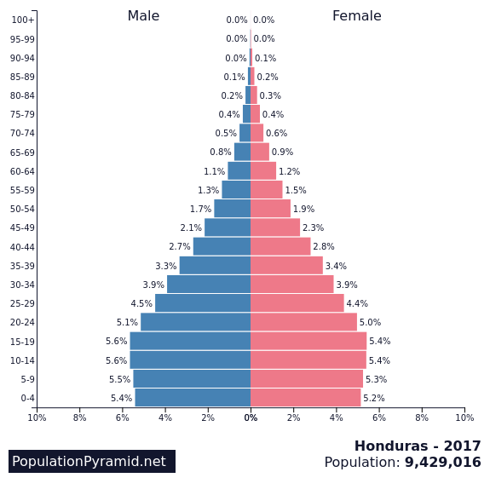
Honduras

Slide 9
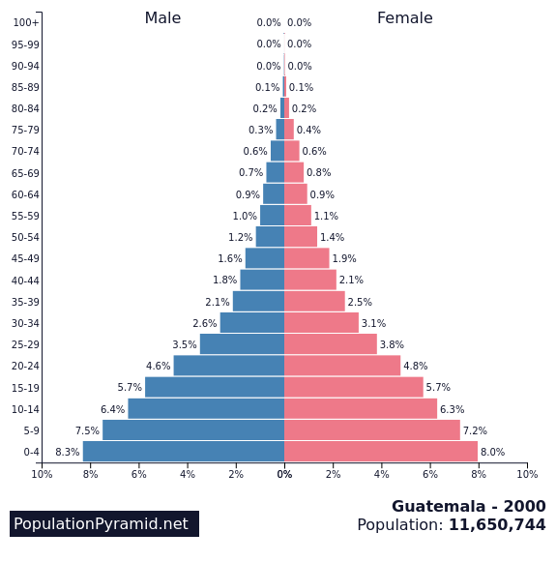
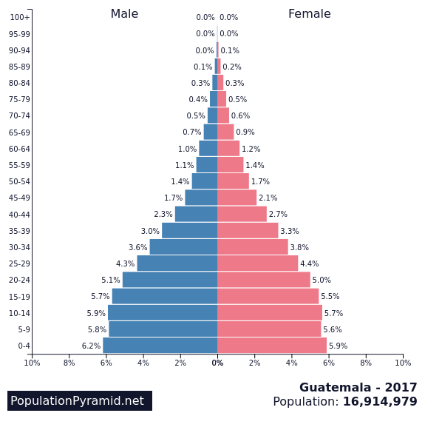
Guatemala 2000

Slide 10
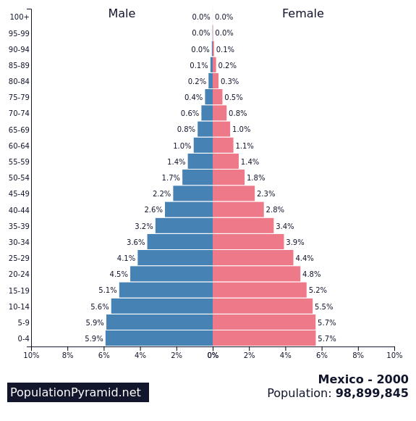
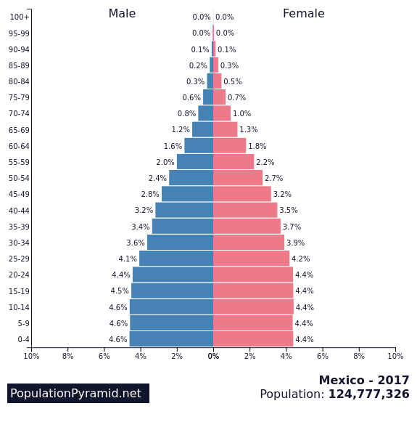
Mexico 2000 vs 2017

Slide 11
Overview

