Slide 1
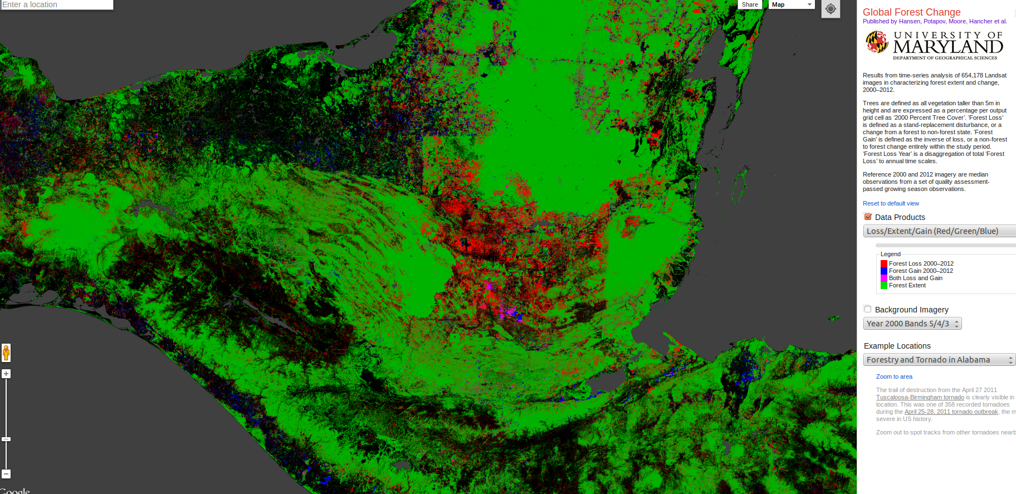
Changes in global forest cover

Slide 2
Statistics on deforestation
UN FAO’s Forest Resource Assessment (FRA) produced at decadal intervals. (http://www.fao.org)
Challenges
Inconsistent methods between countries;
Defining “forest” based on land use instead of land cover regardless of whether tree cover is present;
Forest area changes reported only as net values
Forest definitions used in successive reports have changed over time
Timber production may not be closely correlated with land use change

Slide 3
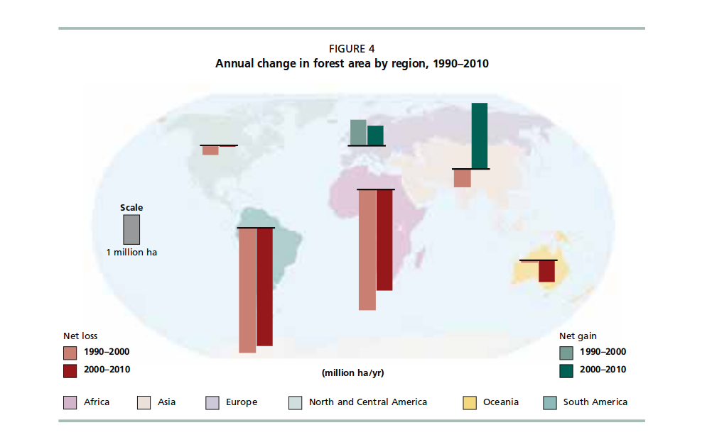
FRA global picture

Slide 4
FAO FRA summary
“At a regional level, South America suffered the largest net loss of forests between 2000 and 2010 – about 4.0 million hectares per year – followed by Africa, which lost 3.4 million hectares annually”
“Asia, which had a net loss of forest of some 600 000 ha annually in the 1990s, reported a net gain of forest of more than 2.2 million hectares per year in the period 2000–2010, primarily due to the large-scale afforestation reported by China”

Slide 5
Improving the picture
FAO reports based on government figures
Remote sensing is a more reliable source of information
Brazil began monitoring Amazonian deforestation at 15 day intervals in 2000 (DETER)
However, many countries do not have detailed monitoring systems in place

Slide 6
Global monitoring
Landsat imagery available at 28.5 m resolution
Landsat 7 completes a full orbit of the earth in about 100 minutes (14 per day).
Complete coverage of the earth every 16 days
Most imagery now in public domain. However processing is challenging
Hansen et al used 650,000 growing season Landsat 7 Enhanced images (total of 1.3 million available at the time of the study)
Built up a global picture of forest cover change from 2000 to 2014

Slide 7
Hansen et al (2013) methods
Google Earth Engine: Cloud platform for earth observation data analysis: Public data catalogue + large scale computational facility with parallel processing of geospatial data
Image resampling,
Conversion of raw digital values to top of atmosphere reflectance,
Cloud/shadow/water screening and quality assessment
Image normalization

Slide 8
Methods
Supervised classification
Image interpretation on screen (based on high resolution imagery) to find change and no change training data for forest cover loss and gain.
Decision tree algorithm applied
20 terapixels of data processed using one million CPU -core hours on 10,000 computers

Slide 9
Results summary
Global forest cover loss 2.3 million square kilometers
Global forest cover gain 0.8 million square kilometers
Context: Land area of the UK is 0.25 million square km
Land area of Mexico is 2 million square km
Land area of Brazil 8.5 million square km

Slide 10
Key points
The tropics were the only climate domain to show a trend (forest loss increasing by 2,000 square kilometers per year)
Brazil: Rate of forest loss declining
Indonesia, Malaysia, Paraguay,Bolivia, Zambia, Angola: Increasing
Boreal forest loss due to fire

Slide 11
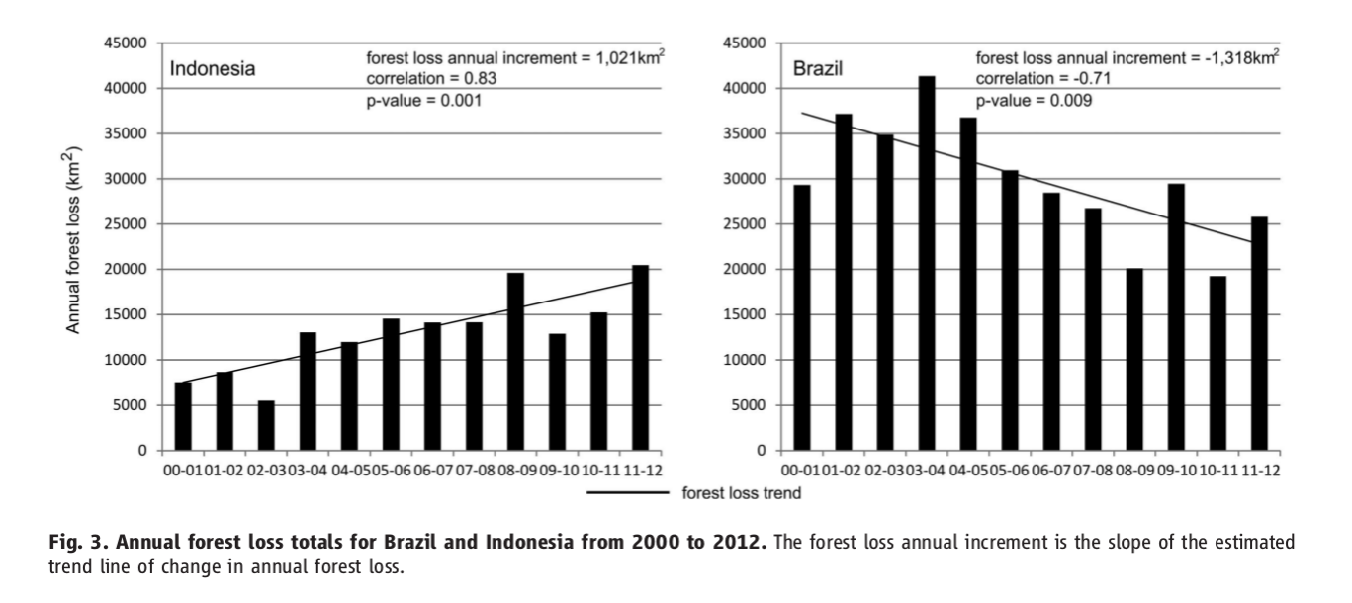
Brazil decline
High point 2003: 40,000 km square per year
2010:2011: 20,000 km square per year

Slide 12
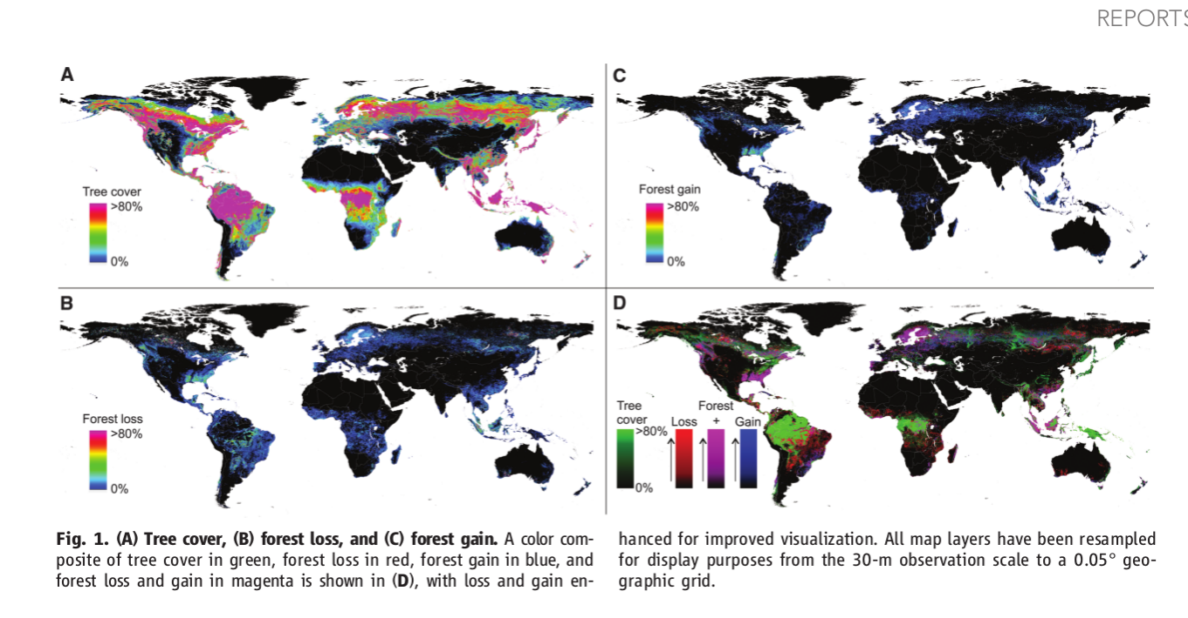
Global patterns

Slide 13
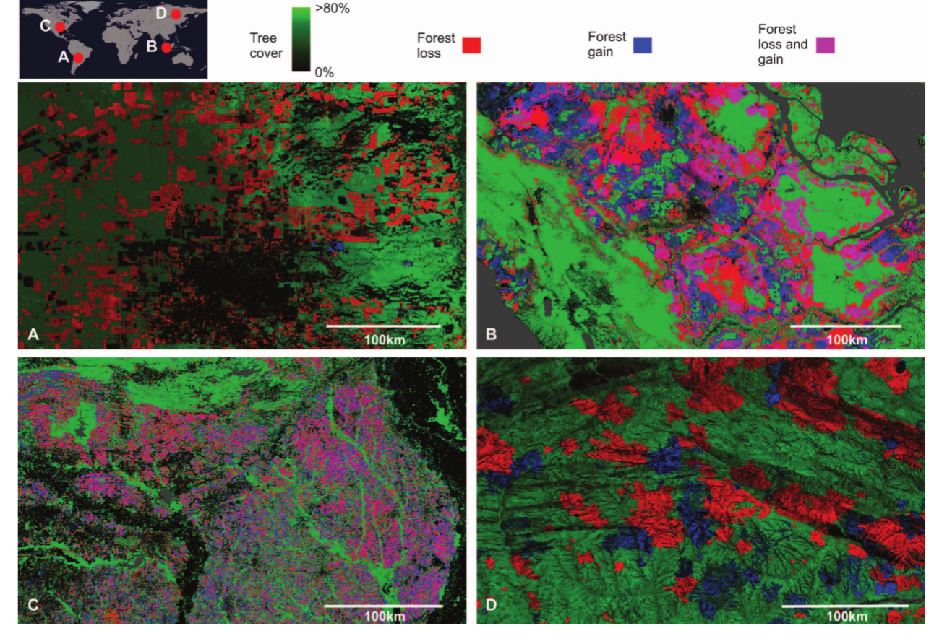

Slide 14
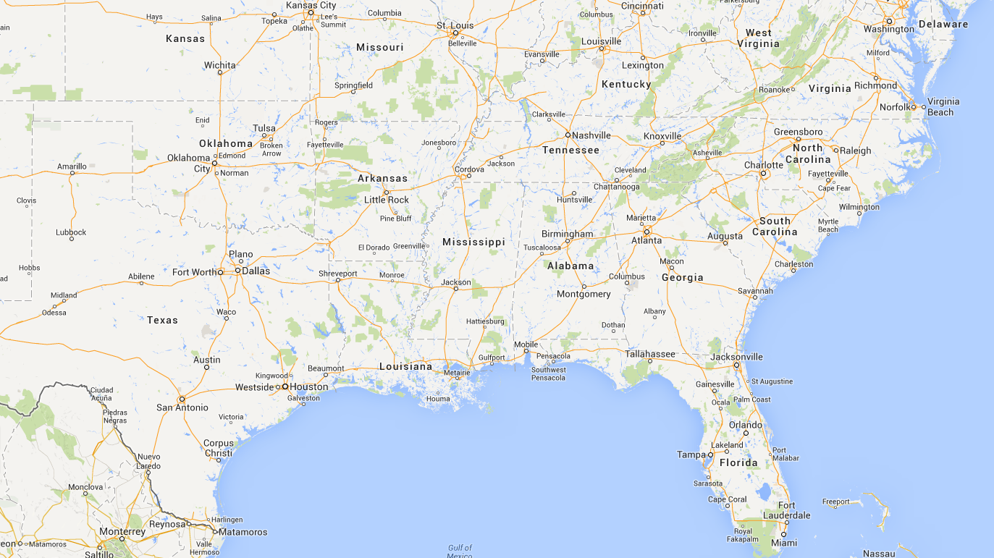
Managed forests
Forest loss +- = Forest gain

Slide 15
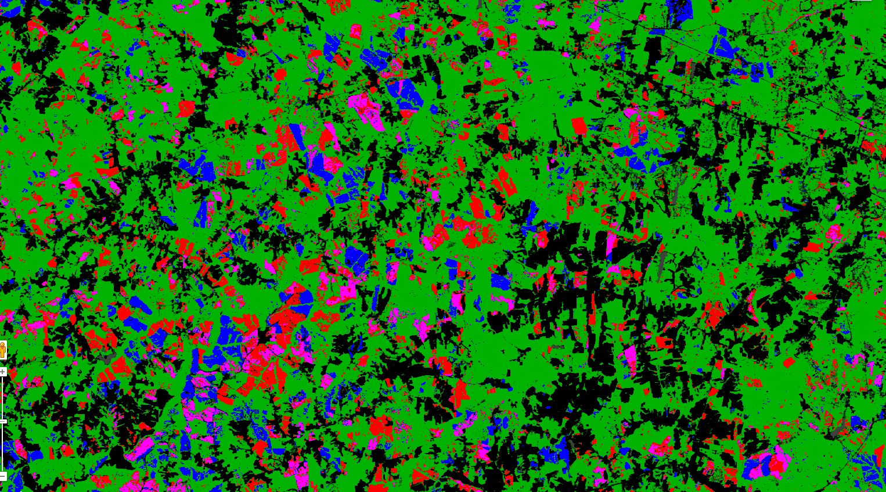
Managed forests
Forest loss +- = Forest gain

Slide 16
Patterns
Sharp boundaries and geometrical shapes (rectangles) suggest planned change and management
Diffuse boundaries and irregular shapes suggest unplanned change (fires, slash and burn, wind throw, disease, natural regeneration)

Slide 17
What is missed?
Selective logging and other small scale forest disturbance
Continuous forest regrowth
Changes in forest composition

Slide 18
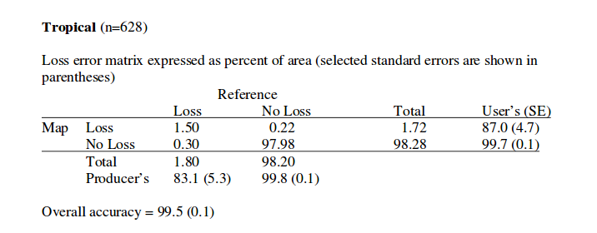
Errors

Slide 19
Drivers of deforestation
Deforestation is affected by economic forces at a global, national and regional scale
Deforestation implies land use change
Land remains deforested permanently if the alternative land use is economically viable
Land may be deforested and degraded by unsustainable land use change
Secondary vegetation is usually of less conservation value than the undisturbed forest

Slide 20
Main drivers of deforestation
Latin America
Subsistence maize production (declining in importance)
Cattle
Soy bean production (Brazil, Paraguay)
Coffee (above 800m)
South East Asia
Clear cut logging
Oil palm
Africa
Subsistence agriculture
Livestock (Forest savannah border

Slide 21
Reduction in deforestation
Brazilian law states that landowners in the Amazon MUST retain 80% forest cover on their land
Costa Rican law prohibits conversion of forest to other uses
PES schemes in place in many countries
REDD initiatives for carbon capture
Mexican laws make legal land conversion complex, costly and time consuming
But … wider economic forces lie behind the change.

Slide 22
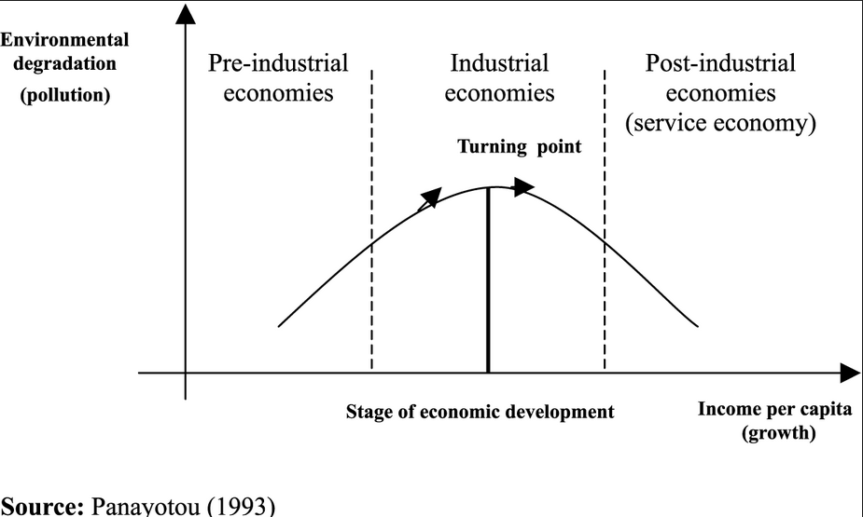
Forest transition
or deforestation

Slide 23
Example of forest transition
Puerto Rico
When Fields Revert to Forest: Development and Spontaneous Reforestation in Post-War Puerto Rico The Professional Geographer Volume 52, Issue 3, August 2000, Pages: 386–397, Thomas K. Rudel, Marla Perez-Lugo and Heather Zichal
Between 1950 and 1990 forest cover increased from 9% to 37% of the island's land area.
In proportional terms more land has reverted to forest in Puerto Rico than anywhere else on earth during the second half of the twentieth century.

Slide 24
GDP per capita (PPP) Source World Factbook
USA $52,000 (Puerto Rico $17,000)
UK $36,000
Russia $17,000
Mexico $ 15,400
Brazil $11,700
Nicaragua, Honduras and Guatemala $4,000 to $6,000
Indonesia, Philippines, Vietnam $3000 to $5000
Haiti $1,100
Madagascar $900
DR Congo $400

Slide 25
Population growth
Mexico 1.2% per annum. Should stabilise by 2050
Brazil 0.9% per annum, declining
Guatemala 2.5% per annum likely to continue
Indonesia 1.2% per annum, slowly declining or stable
Puerto Rico -0.7%

Slide 26
Incipient forest transitions
Middle income tropical countries may show incipient transition
Pressure to deforest for subsistence agriculture is reduced
Industrialisation and urbanisation has led to economic growth
“Rational” land use change continues where it is profitable
Eg. Brazilian law states that only 20% of land in the cerrado (area converted for soya) has to be left forested

Slide 27
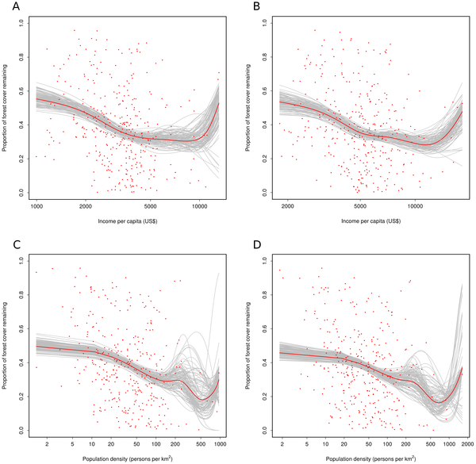
Figure 4. Beta GAM modelling on the relationship between the proportion of remaining forest cover at the municipality level and socio-economic factors.
Vaca RA, Golicher DJ, Cayuela L, Hewson J, et al. (2012) Evidence of Incipient Forest Transition in Southern Mexico. PLoS ONE 7(8): e42309. doi:10.1371/journal.pone.0042309
http://www.plosone.org/article/info:doi/10.1371/journal.pone.0042309

Slide 28
Fragmentation
Deforestation impact on biodiversity may be greater than the figures suggest
Large areas of tropical forest are now fragmented
Fragmentation has a wide range of effects on ecological communities and populations of animals and plants

