Slide 1
Wader and wildfowl population trends in Northern Mucking Flats, Stanford Wharf and Salt Fleet Flats 1999 - 2017
Leo Clarke and Richard Stillman

Slide 2
Contents of the talk
Background and data
Individual species and bird assemblage trends
Recommendations and conclusions

Slide 3
Contents of the talk
Background and data
Individual species and bird assemblage trends
Recommendations and conclusions

Slide 4
London Gateway Consent – Clause 10.5.4
The Harbour Authority will, using all reasonable endeavours, seek to achieve at Sites A and X, in combination with northern Mucking Flats, the necessary intertidal habitat to support such an assemblage of wintering waterfowl. The initial target against which the success of the mitigation and compensation will be assessed shall be that the sites in combination support an assemblage of wintering waterfowl at low tide comprising, on a 5-year mean peak basis at least 7900 birds made up of, in particular, avocet, dunlin and black-tailed godwit in similar proportions to those supported by North Mucking during the winters of 1999/2000 to 2002/2003 (considered in the context of the wider population trends). The target for the overall assemblage have been derived from low water count data for the four winter periods 1999/2000 to 2002/2003 see attached Table B

Slide 5
London Gateway Consent – Clause 10.5.4
The Harbour Authority will, using all reasonable endeavours, seek to achieve at Sites A and X, in combination with northern Mucking Flats, the necessary intertidal habitat to support such an assemblage of wintering waterfowl. The initial target against which the success of the mitigation and compensation will be assessed shall be that the sites in combination support an assemblage of wintering waterfowl at low tide comprising, on a 5-year mean peak basis at least 7900 birds made up of, in particular, avocet, dunlin and black-tailed godwit in similar proportions to those supported by North Mucking during the winters of 1999/2000 to 2002/2003 (considered in the context of the wider population trends). The target for the overall assemblage have been derived from low water count data for the four winter periods 1999/2000 to 2002/2003 see attached Table B

Slide 6
Bird data from three areas used
Northern Mucking Flats
- intertidal habitat within the northern Thames Estuary, a proportion removed by the London Gateway development
Stanford Wharf (Site A)
- coastal set-back scheme (sea defences breached in July 2010), abutting Northern Mucking Flats
Salt Fleet Flats (Site X)
- established in 2016 with the sea breach occurring in September
- data from this site only included in observations from the winter of 2016/17
Data and analyses for combined bird populations from Northern Mucking Flats, Stanford Wharf and Salt Fleet Flats (where available)

Slide 7
Sources of bird data

Slide 8
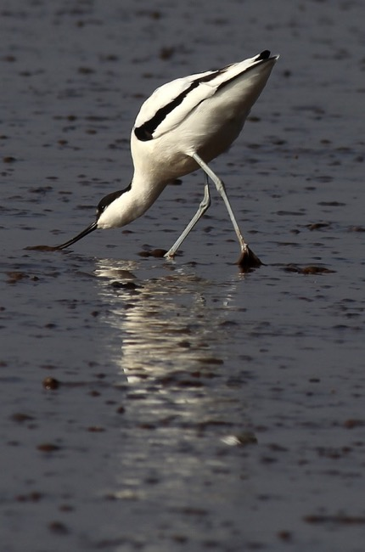
Coastal bird ecology
Many migrate between breeding and non-breeding sites
- large scale conservation issues
Feed on intertidal mudflats while these are exposed by the tide
- limited time for feeding
Have high energy demands
e.g. due to migration and thermoregulation due to living in exposed habitats
Relatively simple systems in open habitats
- Behaviour can be observed
- Food abundance can be measured
Very large wintering populations
- Concentration at a few sites can make populations vulnerable

Slide 9
What causes bird population size in a site to change?
Stochastic events
e.g. weather-related
Changes within the site
e.g. changes in site quality
Changes outside of the site
e.g. changes in breeding success or within other sites

Slide 10
Testing whether site quality has changed
Bird population trends
e.g. comparison of local and Thames Estuary trends
Measure site quality more directly
e.g. changes in food abundance, area or availability

Slide 11
Testing whether site quality has changed
Bird population trends
e.g. comparison of local and Thames Estuary trends
Measure site quality more directly
e.g. changes in food abundance, area or availability

Slide 12
Changes in local and regional population size
Local
Regional
Population size
Population size
Time
Time

Slide 13
Changes in local and regional population size
Local
Regional
Population size
Population size
Time
Time

Slide 14
Changes in local and regional population size
Local
Regional
Population size
Population size
Time
Time

Slide 15
Changes in local and regional population size
Local
Regional
Population size
Population size
Time
Time

Slide 16
Changes in local and regional population size
Local
Regional
Population size
Population size
Time
Time

Slide 17
Changes in local and regional population size
Local
Regional
Population size
Population size
Time
Time

Slide 18
Changes in local and regional population size
Local
Regional
Population size
Population size
Time
Time

Slide 19
Changes in local and regional population size
Local
Regional
0
-
+
Population size
Local quality unchanged
Local quality decline
Local quality increase
+
0
+
Population size
Local quality increase
Local quality unchanged
Local quality increase
-
-
0
Population size
Local quality decline
Local quality decline
Local quality unchanged
Time
Time
Time
Time

Slide 20
Contents of the talk
Background and data
Individual species and bird assemblage trends
Recommendations and conclusions

Slide 21
Data overview
The 19 wader and wildfowl species listed in Clause 10.5.4 are considered to form the overall assemblage of birds.
Avocet, Black-tailed Godwit and Dunlin analysed individually also.

Slide 22
Data overview

Slide 23
Distribution of birds between sites

Slide 24
Data analysis overview

Slide 25
Assemblage trends
Stanford Wharf, Northern Mucking Flats, Salt Fleet Flats
Wider Thames Estuary SPA
Winter
Winter
Grey shading = 95% confidence intervals

Slide 26
Assemblage trends
Error bars
= 1 standard error

Slide 27
Individual species trends
Stanford Wharf, Northern Mucking Flats, Salt Fleet Flats
Wider Thames Estuary SPA
Grey shading = 95% confidence intervals

Slide 28
Individual species contribution to assemblage
Error bars
= 1 standard error

Slide 29
Contents of the talk
Background and data
Individual species and bird assemblage trends
Recommendations and conclusions

Slide 30
Testing whether site quality has changed
Bird population trends
e.g. comparison of local and Thames Estuary trends
Measure site quality more directly
e.g. changes in food abundance, area or availability

Slide 31
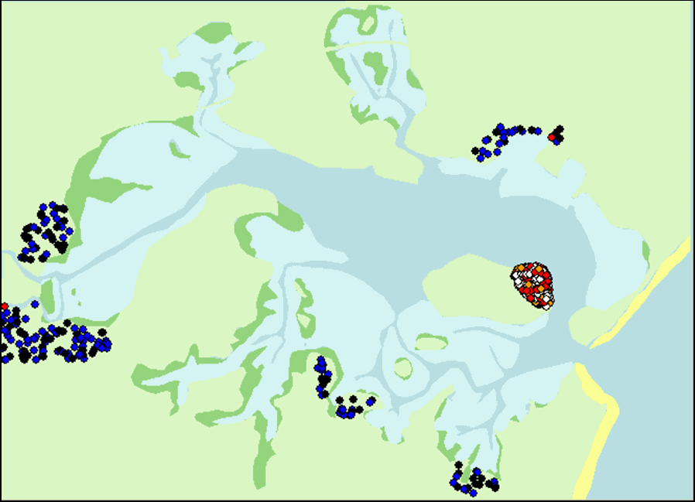
Measuring (or predicting) site quality more directly
?
What does site quality depend on?
- prey species present
- size of prey species
- abundance of prey species
- availability of prey, e.g. through the tidal cycle
- density of competitors
- lack of disturbance / predation risk
How can site quality be predicted?
- using computer models that include the above

Slide 32
Conclusions 1 of 2
How could an effect of the London Gateway development on birds be detected?
If “local” population trends differed from the larger-scale trends across the Thames Estuary
Would also indicate suitability of mitigation sites for compensating for lost habitat
Thames Estuary trends
With the possible exception of 2010 – 2011, assemblage size has not changed between 1999 and 2016/17
There have been overall increases in the population sizes of avocet and black-tailed godwit, and decrease in population size of dunlin between 1999 and 2010
Since 2010 there have not been any significant changes in population sizes of avocet, black-tailed godwit or dunlin
“Local” trends in Northern Mucking Flats, Stanford Wharf and Salt Fleet Flats
Patterns in bird numbers mirrored the larger scale changes across the Thames Estuary

Slide 33
Conclusions 2 of 2
Comparison with target mean peak assemblage
Latest overall 5-year mean peak assemblage across the sites is 6852 birds
This is below the target mean assemblage of 7900 birds, although the latest peak assemblage count during the most recent winter of 2016/17 is 10106 birds, largely due to high numbers of birds present in the newly created site at Salt Fleet Flats
Considerable year to year variation in numbers, both “locally” and in the Thames more widely
Measuring site quality more directly
On-going invertebrate surveys are important to determine the rate with which bird prey species colonise Stanford Wharf and Salt Fleet Flats.
Size of invertebrates of particular importance, as larger invertebrates tend to be more profitable for the birds.

