Slide 1
Is Wareham forest a fragile ecosystem?

Slide 2
Yes?
There is evidence of resistant systems e.g., corsican bark. However, it can be argued that interference from humans makes this system more resistant by using the management technique of thinning. The removal of deadwood can prevent fires from spreading as rapidly.
In some areas, bracken had been completely burnt and has not grown back as quickly (not as resilient). The next slide shows an area wherein bracken has not yet grown back as rain has washed away the fertile topsoil
Coniferous forests typically have podzolic soil - this is highly acidic soil that inhibits the decomposition of organic materials. The more it builds up, the more acidic it becomes (positive feedback). Cruddy vegetation such as bracken goes into soil and doesn’t decompose and leads to organic matter that isn’t good for growth due to a lack of nitrogen for plants. There is some productivity but it cannot be used to graze.

Slide 3
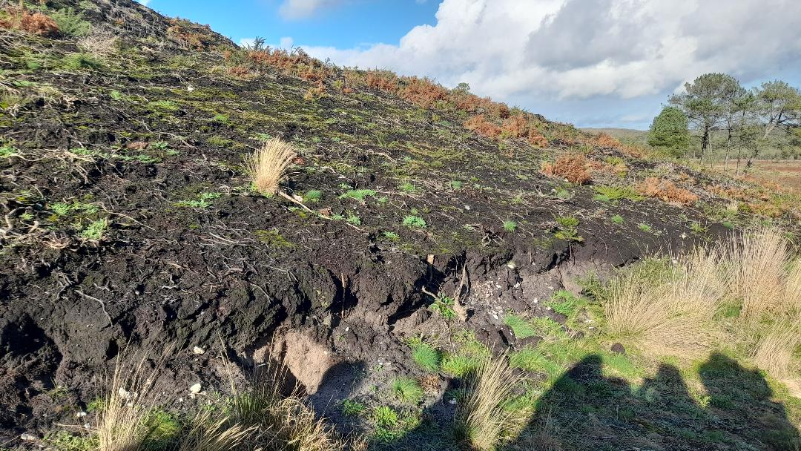
This area has not recovered as quickly. Due to its steep slope, rain is removing the fertile topsoil which is preventing the rapid growth of bracken and other vegetation

Slide 4
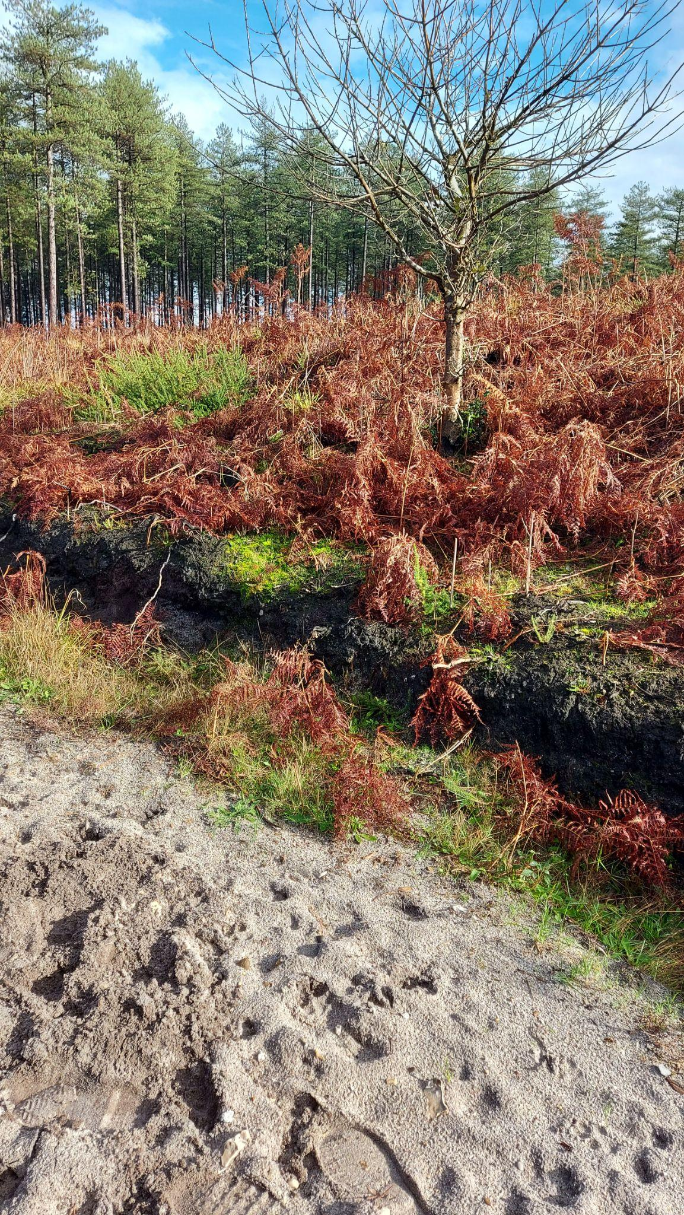
Soil conditions have changed around the area where the fire was located.
Here, pozdol (grey soil) is present, which is infertile and limits soils for productive usage. They have a pH level around 6 and below which causes a lack in plant nutrient availability for vegetation to grow
The dark soil on top is pure organic matter because of decomposition. This builds up an organic layer, creating positive feedback and makes it harder for microbes to function - difficult to reverse
This forms naturally but underneath consists of cruddy acidic vegetation, prone to enhance bracken growth. This will then cause the organic material to increase acidity, potentially spreading and affecting the ecosystem by preventing growth of new vegetation.

Slide 5
No?
Evidence of resistant systems - Corsican pine seen in Wareham forest was affected by the fire in 2020 but has remained largely unchanged. They appear to be resistant to fire due to their thick bark and still have use of pine cones in the top canopy that open to release seeds
Many young tree species (e.g. Corsican pine trees) are seen growing over the landscape (means suitable conditions are still present), some gorse species have sprouted (resistant to fire) and festuca grassland has begun growing
Resilient species such as bracken have seen rapid re-growth back in areas that were affected by the fire
On the other side of the path from where the podzolic soil is seen, we can see grasses growing. This may be due to the fire burning off the top layer of bracken which then turns into ash. As this is alkaline, it increases the pH of the soil which then allows these grasses to grow. This then creates a mosaic landscape (open grassland and pine forest)
This mosaic landscape can be beneficial as it would prevent the spread of fire and reduce the amount of combustible material.
Pylons help to fragment the forest meaning fires will not be able to spread as easily (beneficial side effect).
Foresters carry out thinning cycles every 5-10 years to remove less vigorous trees to make room for the more vigorous ones - If this wasn’t done, the less successful trees (poor health) would starve the healthy trees from light and food resources - this proves that management of the forest is easy to comply with and isn’t so fragile - if the forest was fragile, this wouldn't necessarily be possible

Slide 6
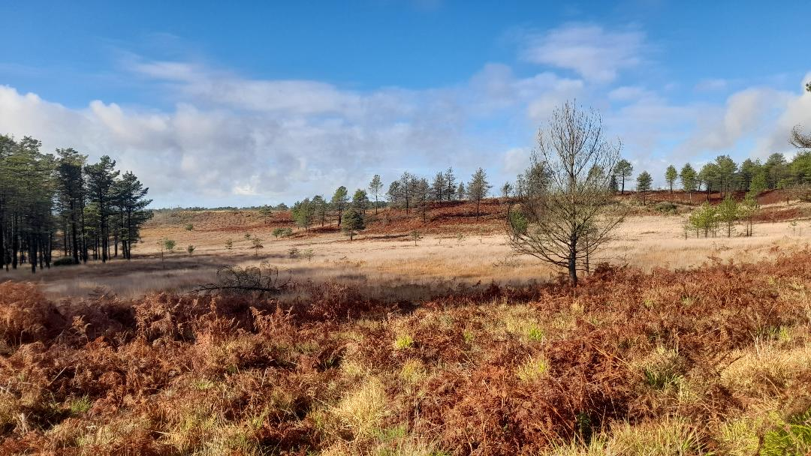
An open grassland with mixture of young pine trees has been formed by the fire, creating a mosaic landscape

Slide 7
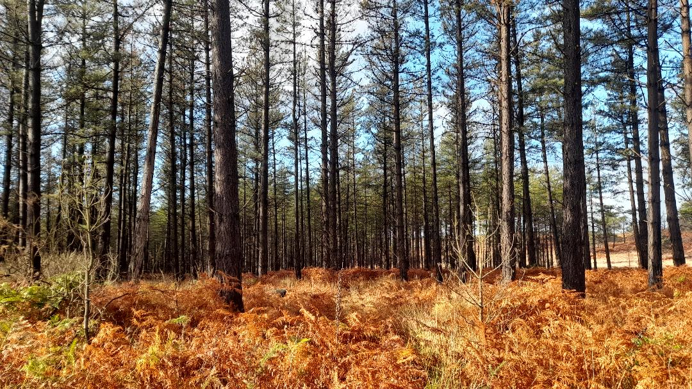
The resistance of these corsican pines mean that they have remained largely unaffected

Slide 8
Conclusion
Overall, Many Scots pine trees, Corsican pine trees and other species have become fire resistant and have remained in place after the fire in May 2020. The grassland area has begun resprouting new grasses and unplanted Corsican pine trees have been seen growing.
Plant species that are exposed more frequently to fire show resilience and can develop adaptive traits e.g., seritony in pines (prolonged storage of seeds until triggered by an environmental factor such as fire) or thicker bark so that they are more resistant to burning (Harrison et al. 2021). Even though the fire that affected Wareham in 2020 was likely caused by humans and was perceived as wholly negative, from an ecological perspective wildfires can be beneficial for ecosystems and for plant species that depend on it for their persistence.
Although some parts have been burnt to the point where no vegetation has been able to grow, the majority of Wareham Forest where the fire took place, has grown back to a generally healthy and stable state as much of the landscape has shown resilience despite the effects of the fire.

Slide 9
References
Harrison, S.P., Prentice, I.C., Bloomfield, K.J., Dong, N., Forkel, M., Forrest, M., Ningthoujam, R.K., Pellegrini, A., Shen, Y., Baudena, M. and Cardoso, A.W., 2021. Understanding and modelling wildfire regimes: an ecological perspective. Environmental Research Letters, 16, 125008.

